Slide 1
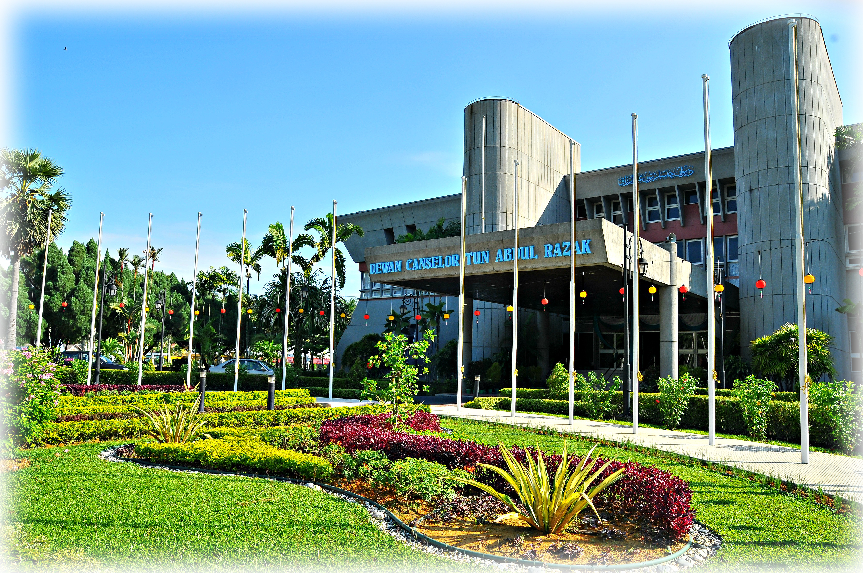
INDUSTRIAL PROJECT BRIEFING
By: Industry & Community Engagement Unit (HEJIM), FTSM UKM.

Slide 2
OUTLINE
INDUSTRIAL PROJECT
COURSE EVALUATION
IMPORTANT DATES

Slide 3
Industrial Project –TTTT4076
The industrial project is a compulsory course for the study program that needs to be implemented to meet the graduation requirements.
Industrial project aims to provide opportunities to students use their knowledge in computing area to solve real problems faced by the industry. During this project the students will used the skills to understand the problem and propose the solutions of the problem. Students also need to design and develop the effective proposed solution. At the end of the project, students are required to write a project report and verbally present to the supervisor.
A project report according to the format needs to be sent to the faculty and student achievement will be assessed according to the prescribed assessment methods and formats.

Slide 4
COURSE LERANING OUTCOME
Identify the appropriate methods to solve the industrial project.
Propose the effective solutions for the industrial project.
Integrate the existing and new information technology knowledge to solve the industrial project.
Develop the industrial project based on the real problem in industry.
Present the industrial project outputs.

Slide 5
TYPE OF INDUSTRIAL PROJECT
System/Apps/Webs Development
System/Webs Enhancement
Product/Software Assessment
System Study
Network Development
Product /Software Deployment
Software/Product Maintenance
System Documentation

Slide 6
Definition of Project Categories
System Development
System development involves the process of defining, designing, testing and implementing a new software application or program. It could include the internal development of customized systems, the creation of database systems, or the acquisition of third party developed software.

Slide 7
Definition of Project Categories
System Enhancement
System enhancement involves any product change or upgrade that increases software or hardware capabilities beyond original client specifications. Enhancements allow software and hardware product performance scalability. In general, product enhancements include: additional functionality, error/bug repair, increased processing speed, or better cross-platform compatibility.

Slide 8
Definition of Project Categories
Product/Software Assessment
During a product/software assessment, the fit between the product/software and the users’ needs of that product/software are determined. This fit concerns both explicit and implicit needs about the product/software. This is often referred to as ‘product/software quality’. By on the one hand examining the needed level of product quality, and on the other hand examining whether a product meets that level of quality, fitness for use is evaluated. This can be done during several phases of development and use, which results in increased control during the transformation from investment decision to actual implementation.

Slide 9
Definition of Project Categories
System Study
A detailed study to determine whether, to what extent, and how automatic data-processing equipment should be used; it usually includes an analysis of the existing system and the design of the new system, including the development of system specifications which provide a basis for the selection of equipment.
During this process, data are collected on the available files, decision points and transactions handled by the present system. Interviews, on-site observation and questionnaire are the tools used for detailed system study. Using the following steps it becomes easy to draw the exact boundary of the new system under consideration:
-Keeping in view the problems and new requirements
-Workout the pros and cons including new areas of the system
All the data and the findings must be documented in the form of detailed data flow diagrams (DFDs), data dictionary, logical data structures and miniature specifications. It includes planning for the new system, analysis of requirement, system constraints, functions and proposed system architecture, prototype of the proposed system and its analysis.

Slide 10
Definition of Project Categories
Network Development
Network development focuses on the building, scaling and automation of networks to process data more efficiently. Core activities include enabling reliable/secure communications over unreliable/insecure channels, identifications of paths and objects through a network, managing network sharing resources among competing entities, and development of network applications.

Slide 11
Definition of Project Categories
Product/Software Deployment
Software deployment is the process of getting the product ready for market. Software deployment brings many key advantages to enterprises. Tasks like installing, uninstalling and updating software applications on each computer are time consuming. Software deployment services reduce the time and make the process error free. The software can be easily controlled and managed through deployment.

Slide 12
Definition of Project Categories
Software Maintenance
Software maintenance in software engineering is the modification of a software product after delivery to correct faults, to improve performance or other attributes. A common perception of maintenance is that it merely involves fixing defects.

Slide 13
Definition of Project Categories
Systems Documentation
System documentation is a vital and important part of successful software development and software engineering. Generally speaking, it is comprised of detailed language, illustrations and photos that help different people understand the software, and it is essential reference material.
System documentation includes things like source code, testing documentation and API documentation (programmers’ documentation or instructions). It describes the requirements and capabilities of the software and informs the reader about what the software can and can’t do – in other words, its functionality.

Slide 14
SAMPLE OF INDUSTRIAL PROJECT

Slide 15
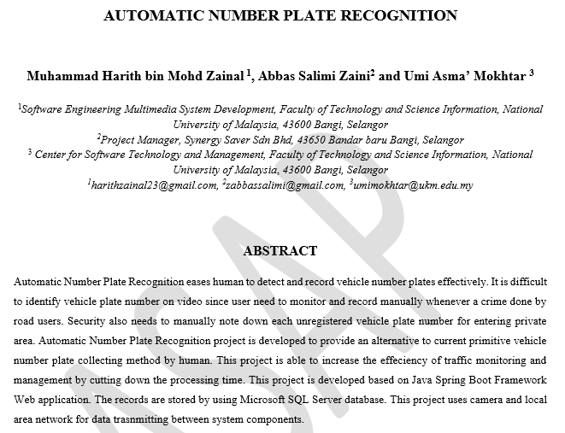
SYSTEM DEVELOPMENT

Slide 16
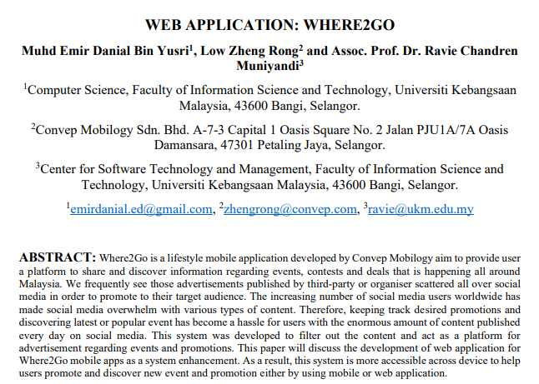
WEB APPLICATIONS

Slide 17
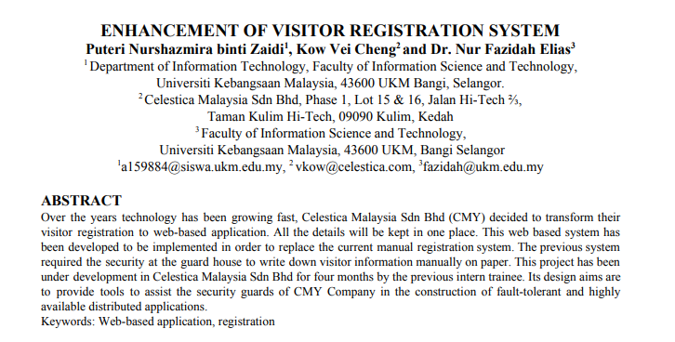
SYSTEM ENHANCEMENT

Slide 18
APPS DEVELOPMENT

Slide 19
SYSTEM STUDY

Slide 20
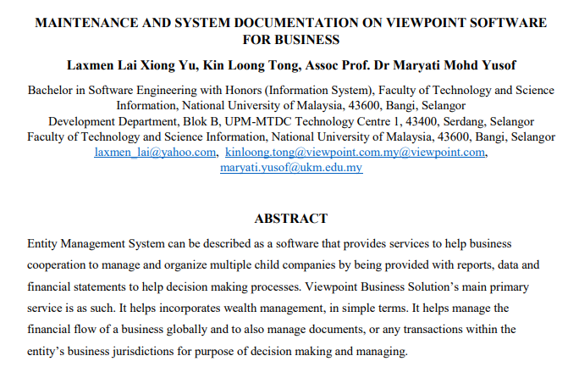
Maintenance and Documentation

Slide 21
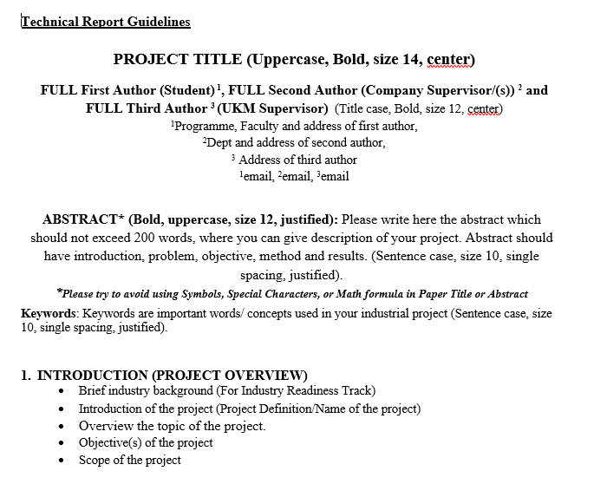
TECHNICAL REPORT FORMAT

Slide 22
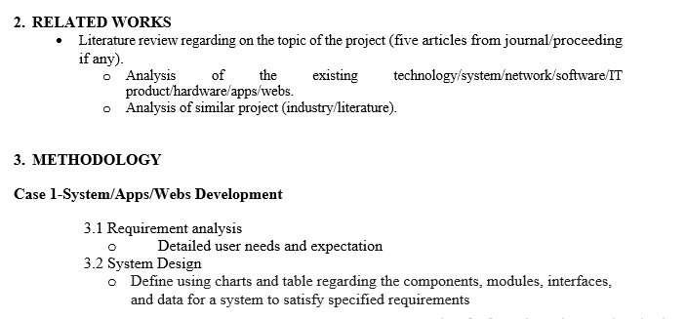

Slide 23
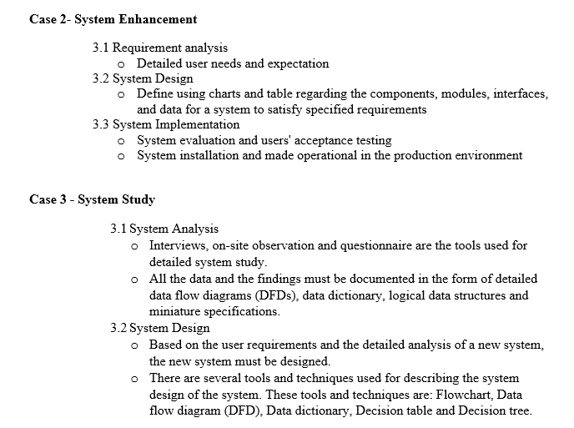

Slide 24
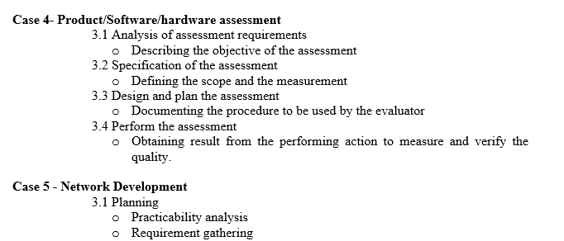

Slide 25
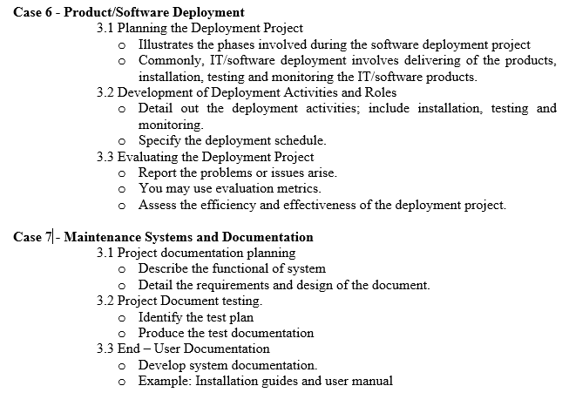

Slide 27
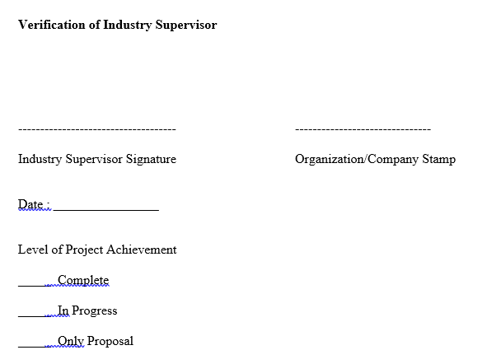
Number of pages : 20 – 30 pgs

Slide 28
COURSE EVALUATION

Slide 29
COURSE EVALUATION
TRACK | CONTENTS | EVALUATOR | MARKS (%) | STATUS
INDUSTRIAL READINESS & RESEARCH | Industrial Training(TTTT4056) Logbook Performance Evaluation | Industrial Supervisor | 40 60 | PASS/FAIL
 | TOTAL |  | 100
 | Industrial Project (TTTT4076) Progress Assessment Technical Report Poster Presentation (KLIK) | Faculty Supervisor | 20 50 30 | GRADE A-E
 | TOTAL |  | 100
ENTERPRENEUR-SHIP | Industrial Training (TTTT4056) Logbook Performance Evaluation | Industrial Supervisor | 40 60 | PASS/FAIL
 | TOTAL |  | 100
 | CMIE3016 | Lecturer | 100 | GRADE A-E
*If a student FAIL in TTTT4056 Course, it means that he/she fails for TTTT4076 Course

Slide 30
Component of Evaluation TTTT4056
LOG BOOK (40%)
-Ability to write weekly activities in log book.
-Ability to maintain clear, concise and relevant entries in log book.
-Ability to well written, readable and free from grammar/spelling mistakes.
-Ability to provide concise and complete conclusion followed from the weekly report
STUDENT'S PERFORMANCE (60%)
-Attitude
-Communication Skills
-ICT Skills
-Knowledge
-Critical Thinking And Problem Solving

Slide 31
Component of Evaluation TTTT4076
Progress Assessment (20%) Via email or appropriate social media. Frequency of communication between supervisor and student at least 5 times during industrial training.
Discussion of proposed solution
Discussion of solution procedure
Technical Report (50%)
1. Appropriate solution method
2. Integration of existing and current knowledge
3. Appropriate project design
4. Complete project results
5. Clear project summary
Presentation (30%)
1. Convincing presentation
2. Attractive presentation material
3. Neat appearance

Slide 32
KARNIVAL LATIHAN INDUSTRI & KERJAYA (KLIK)
WHAT IS KLIK – Karnival Latihan Industri dan Kerjaya
OBJECTIVE
Empowering students through the presentation of projects implemented throughout the industrial training.
Celebrate the success of students completing industrial training as a final course at UKM.
ACTIVITIES
Reflection session
Poster Presentation
Walk-in Interview
WHEN? Semester 2

Slide 35
IMPORTANT DATE
Start of Application Placement
23 March 2020 to 15 August 2020
Start of Industrial Training
1 September 2020
End of Industrial Training
14 or 15 January 2021 (20 weeks)
Technical Report and Poster Preparation
18 Jan – 12 March 2021
Technical Report Submission
15 March – 19 March 2021
(Faculty SV)
22 March – 31 March 2021
( Industry SV)
KLIK
6 APRIL 2021
(*Subject to amendment)
Submission of Technical Report After Correction
12 to 18 APRIL 2021

Slide 36
DOCUMENTS TO SUBMIT
Borang tamat latihan (Completion form)
Surat permohonan laporan teknik (Application letter for technical report)
Surat penerimaan laporan teknik (Acceptance letter for technical report)
Laporan teknik (technical report)
Poster
1 & 2 – after end of internship
3 & 4 & 5 - after KLIK

Slide 37
THANK YOU

